Slide 1
How to market your app with social media

Slide 2



GOOD TO KNOW
Retweeting is nice and easy
COMMON PITFALLS
Adding to the noise
DO OR DIE
Follow before you lead
Listen before you leap
Social media requires social skills
and the biggest faux pas is trying to
broadcast a message before you’re part
of the conversation. So before you start
talking about your app, you should start
by listening to what people are saying
on tech blogs, app review sites, Twitter,
and Facebook, as well as Windows Store
app reviews. You can automate a lot of
this by connecting your inbox to your
social networks with Social Connector for Outlook.

Slide 3


Dive in slowly
Test the waters by following some influential app bloggers on Twitter. Dip your toe in by commenting on some Facebook threads in full swing. You’ll find out what people are talking about and get a good idea of who’s influencing who. And if you really want to geek out, check out Forrester’s social technographics tool to find out where your audience lives and plays online so you can create a more targeted strategy.
1.
Launch a Facebook page and Twitter account and post regular updates, insider tips, and
special offers
2
Create a website for your app that’s linked to Facebook, Twitter, and your Windows Store page
3 Use the App Descriptorizor, your app icon, and Windows Store screenshots to help to tell your story

Slide 4
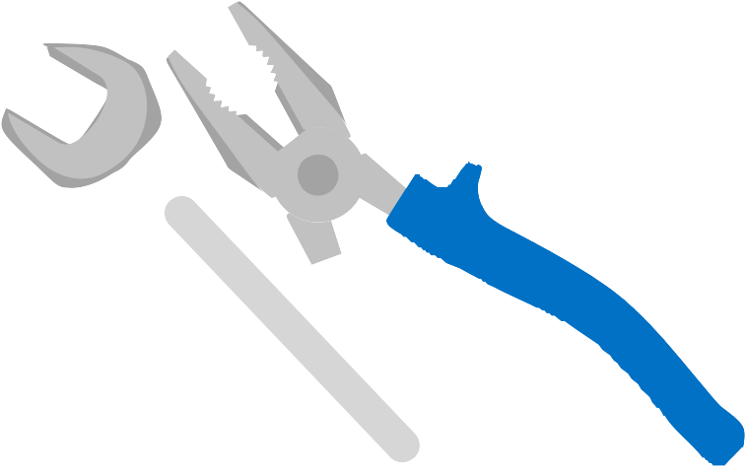

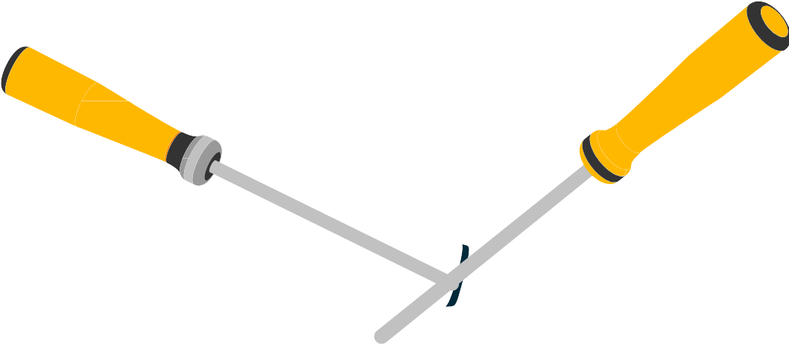

Build some bridges
On any social network, you matter most as a bridge – from one idea or news story to the next, from person to person, and from problem to solution. The more you help people connect with valuable content, the more they’ll look to you as a resource. And sometimes, the solution they come looking for is your app.
GOOD TO KNOW
Your audience is inundated
COMMON PITFALLS
Overhyping your app
DO OR DIE
Spam and get banned

Slide 5
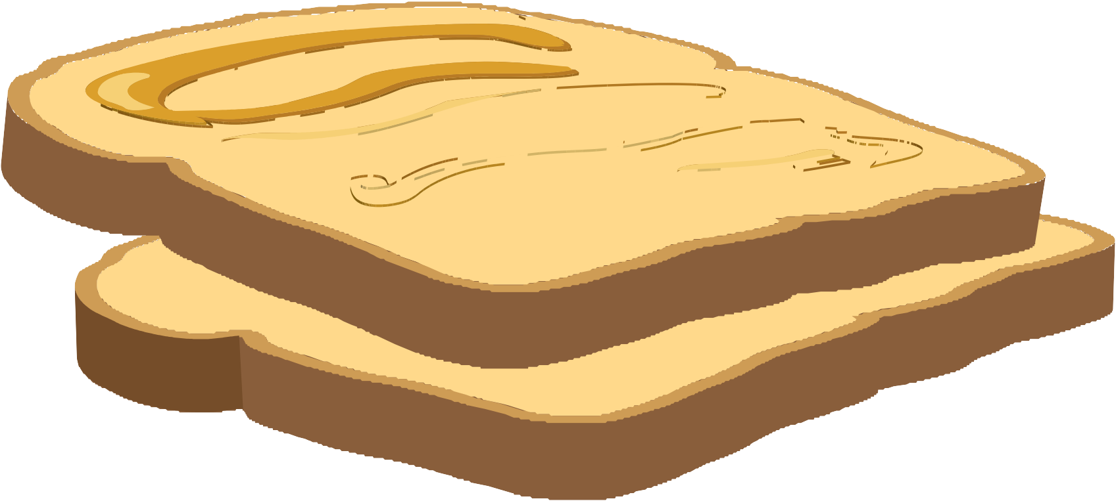


Spread the word
GOOD TO KNOW
Shrink links with
bit.ly
COMMON PITFALLS
Too much, too fast
DO OR DIE
Be yourself
Now that you know what to say and where to say it, it’s time to start contributing. Remember that social media is about maintaining a good dialogue. Post frequently. Keep things interesting. Stay timely. Be credible.
Keep it conversational. Your blog, Twitter, and Facebook timeline are only as interesting as your latest post. The perfect combination of length, content, and tone will vary from channel to channel.

Slide 6







ROCK•IT
ROCK•IT
ROCK•IT
ROCK•IT
Market like an indie band
Long-time rocker and Wordament developer John Thornton says that, just like an indie band, you’ve gotta go DIY to spread the word, or else your app won’t play.
ROCK•IT
ROCK•IT
ROCK•IT ROCK•IT
ROCK•IT ROCK•IT
ROCK•IT
ROCK•IT
ROCK•IT
ROCK•IT
ROCK•IT
ROCK•IT
ROCK•IT ROCK•IT
ROCK•IT ROCK•IT
Recruit friends, family, and co-workers. Get them to download your app, rate it, and spread the word on Facebook, Twitter, and in the analog world. And always be sure to link all your marketing back to your social channels with a trackable bit.ly link or digital tag so you can keep engaging with your fans.
ROCK•IT
ROCK•IT
ROCK•IT
ROCK•IT
ROCK•IT
ROCK•IT
ROCK•IT ROCK•IT
ROCK•IT ROCK•IT
Create posters and stickers for your app and post ‘em on walls, laptops, at bars, or anywhere else your target audience hangs out
Put together a limited run of T-shirts and hand them out to
your biggest fans so they can be your walking billboards
Cold-call an influential app blogger and give them a reason to write about your app

Slide 7
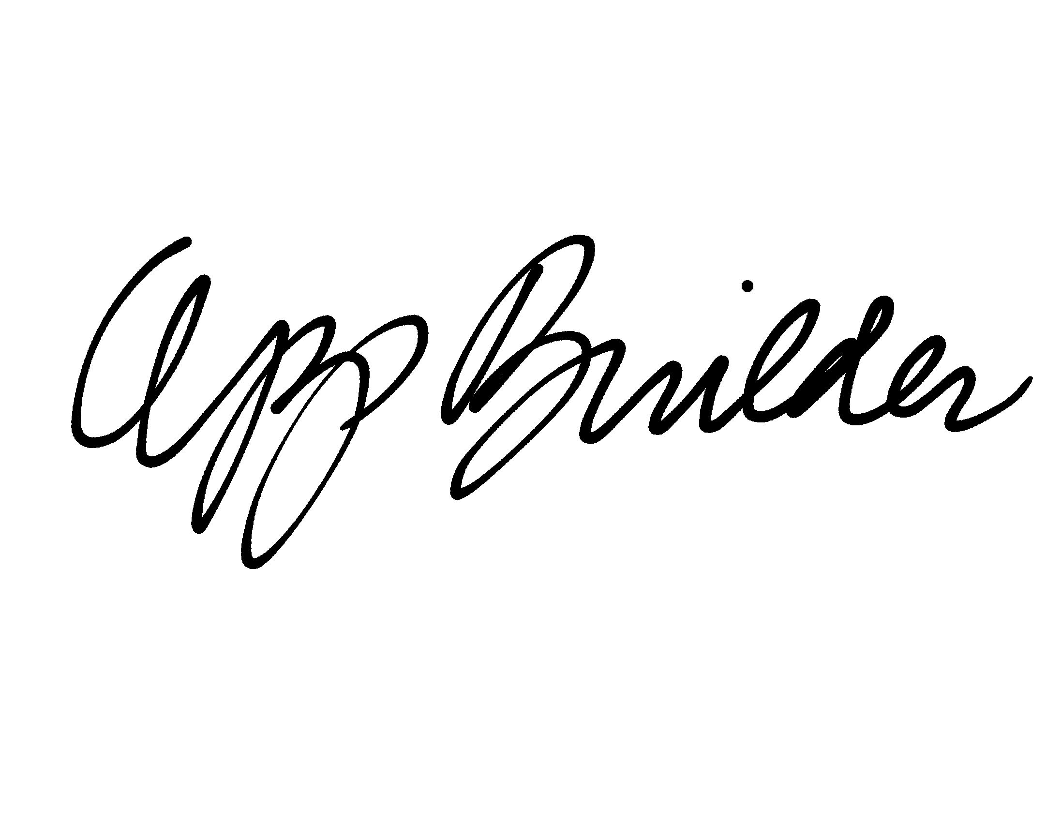
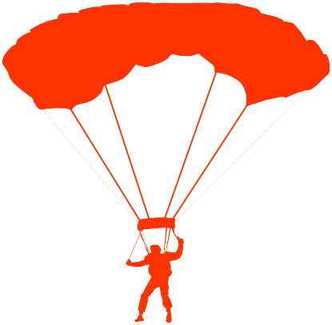
Keep an updated list of who your app ambassadors are and build the list over time Motivate sharing with a contest (e.g., “Share my app with ten friends and get free
in-app points”)
Reward influencers with insider knowledge, social media kudos, and if necessary, free pizza
SIGNATURE OF APPLICANT
Enlist
You can spend all your time and money
trying to reach the millions or you can enlist a small group of influential people eager to spread the word for you. If you can recruit a core team that loves your app and is willing to talk about it, you’ll be well on your way to building an army of app ambassadors. And if you can give them the motivation they need to spread the word, they’ll market your app till the cows come home with minimal investment on your part.
an army

Slide 8



Give away your app to a limited number of people to drive up your numbers and give your reviews a boost
Generate buzz
1
Launch a YouTube contest where fans send in videos of themselves competing or using your app in a unique way
2
People are overwhelmed with endless ads, Tweets, and status updates which means you’ll have to figure out some way to cut through the noise and grab their attention. You won’t do it by shouting. But you will do it by doing something remarkable.
And once people start remarking, you can fuel their buzz by giving them crazy props and mad merchandise (stickers, t-shirts, posters, or whatever you can dream up).
3
Invite your biggest fans to join you for an in-person event or competition built around your app

Slide 9
Keep your ear to the ground
n
o
i
t
n
,
e
s
M
w
l
a
e
ci
n
o
p
S
p
h
a
it
of
ds
w
p
n
o
re
t
t
n
e
d
g
a
o
n
k
p
o
y
a
o
b
e
ta
,
c
s
a
S
n
F
r
o
u
o
ti
h
y
a
t
s
i
er
w
v
t
n
n
e
o
m
c
e
g
a
g
n
e
u
S
i
t
t
o
e
k
o
c
h
H
t
i
a
s
w
As you build momentum, it’s important to never stop listening to what people are saying about your app. Embrace criticism and use it to up your game. Grace under fire can earn you more followers than one bad
comment will ever lose. If you get a series of negative reviews, you can always balance it out by asking your biggest fans to head on over to the Windows Store and rate your app.
tr
r
e
c
o
n
e
t
u
l
s
f
t
n
h
i
h
g
t
i
i
s
w
n
e
I
g
e
c
k
a
n
a
m
o
g
r
o
f
o
n
r
e
e
b
p
e
d
p
c
n
p
a
a
a
F
s
e
e
n
z
s
y
o
l
U
i
a
t
n
n
a
e
o
m
t
l
p
a
i
U
c
d
o
e
s
k
k
r
c
a
a
M
r
e
T
s
10
U

Slide 10

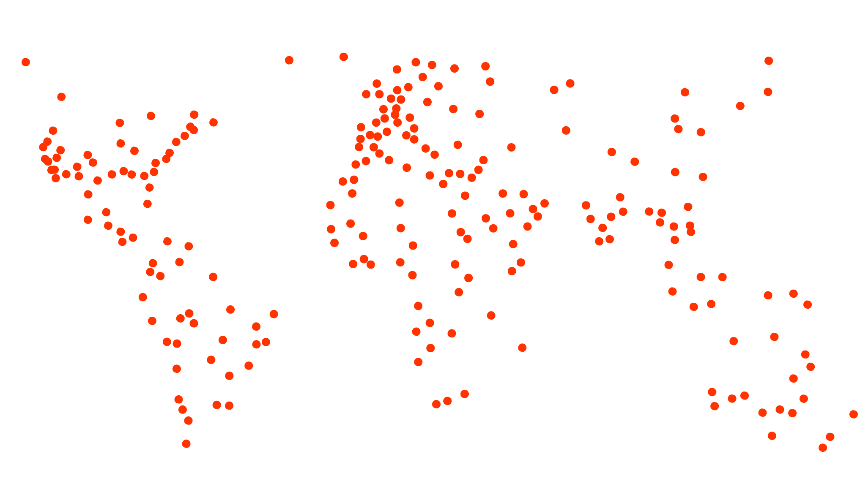

Rule the world
GOOD TO KNOW
You are a marketing genius
COMMON PITFALLS
Quitting too early
DO OR DIE
Always have fun
You’re almost to the end of the guide, but this is just the beginning of your marketing adventure. Because if you’re really successful, your fans will be begging for the next version of your app. And you can use all the great feedback
you get along the way to make your app and your marketing even better so you can reach even more people, get more downloads, and maybe even rule the world. That’s the beauty of social media.

